Slide 1
FACE MASK DETECTOR
MEMBERS
G.SWATHI(511919104019) K.SWAPNA(511919104306) B.SWETHA(511919104020) B.E-3rd YEAR&6th SEMESTER DEPARTMENT OF CSE
UNDER THE GUIDANCE OF
Ms.A.Vanathi,ASP

Slide 2
ABSTRACT
The basic aim of the project is to detect the presence of face mask on human faces on live streaming video as well as on images.
The proposed method detects the face from the image correctly and then identifies if it has a mask on it or not.

Slide 3
REQUIREMENT SPECIFICATION
Software :
Python
OpenCV
Deep learning
Hardware :
Camera

Slide 4
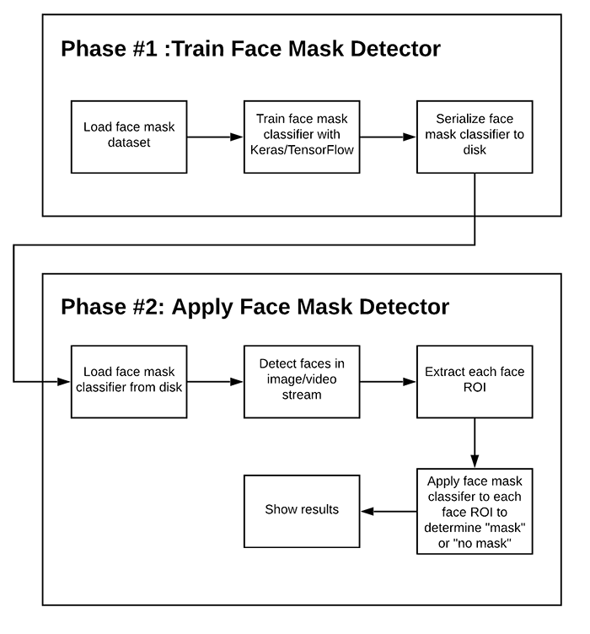
DATA FLOW DIAGRAM

Slide 5
MODULE DESCRIPTION
Camera module:
This module helps to capture the image or record the video. Hence, we can able to process this images using our image processing module.
Image Processing Module :
With the help of image processing and deep learning, a person who is intended to monitor the people can be seated in a remote area and still can monitor efficiently and give instructions accordingly.
Open CV:
Open CV (Open Source Computer Vision Library) is a collection of algorithms for computer vision.

Slide 6
MODULE DESCRIPTION
Tensor Flow:
Tensor Flow is a mathematical computation library for training and building your machine learning and deep learning model with a simple to use high level APIs.
Dataset module:
The dataset pictures for covert and unmasked faces were collected from images dataset offered within the public domain. The data set is collected for the training the face mask detection model.
Web interface module:
The web interface module helps to view the masked and unmasked user data in the User Interface

Slide 7
LITERATURE SURVERY
ATHOR | LITERATURE SURVERY | APPROACH | YEAR
Salem Aleyani,huan Liu | Ensemble Feature Selection in Face Recognition ICMLA 2012 challenge | Fitter –based Feature selection | 2012
Emir Kremic, Abdulhamit Subasi,and Kemal Hajdarevic | Face Recognition Implementaion on for client server mobile application using PCA | Client-server model and GPG infrastructure | 2012

Slide 8
EXISTING SYSTEM
The absencd of large datasets of ‘with_mask’ images has made this task more cumbersome and challenging.
We should have a system security to monitor the crowed and enforce everyone to wear a mask.

Slide 9
PROPOSED SYSTEM
In the proposed system, the Face Mask Detection Platform uses Artificial Network to recognize if a user is not wearing a mask.
The goal of face detection is to determine if there are any faces in the image or video.
If multiple faces are present, each face is enclosed by a bounding box and thus we know the location of the faces.

Slide 10
ADVANTAGES
Robust and also has a high detection rate.
Fast and Accurate face detection.
Efficently detect the faces.
Easy to implement.

Slide 11
DISADVANTAGES
Applicable only to frontal. may not detect faces with breads
Convolution cost is high.
It has high dimensional feature vector.
Low detection rates.

Slide 12
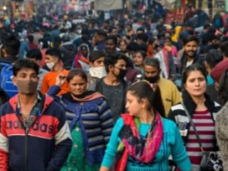
INPUT IMAGE

Slide 13

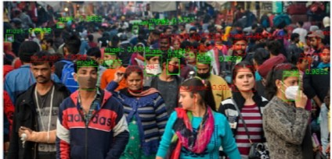
OUTPUT IMAGE

Slide 14
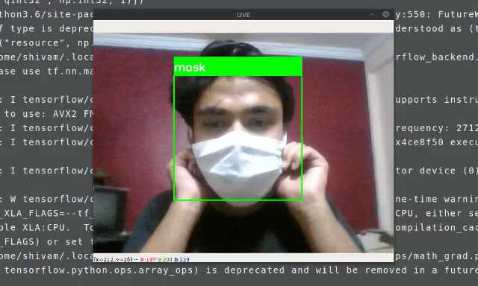
FACE MASK DETECTOR

Slide 15
CONCLUTION
From the experiment result it is able to detect and distinguish a non-wearing and a wearing-mask precisely with any condition of surrounding environment . In the future, we will be add the thermal detection on this deice to help the guard’s work easier. Furthermore, this device is hopped to be installed in other crowd area which need face mask detector.

Slide 16
REFREENCES
1. Ariyanto, Mochammad & Haryanto, Ismoyo & Setiawan, Joga & Muna,
Munadi & Radityo, M.. (2019). Real-Time Image Processing Method
Using Raspberry Pi for a Car Model. 46-51.
2. V. K. Bhanse and M. D. Jaybhaye,(2018) "Face Detection and Tracking
Using Image Processing on Raspberry Pi," 2018 International Conference
on Inventive Research in Computing Applications (ICIRCA),
Coimbatore, India, pp. 1099-1103.
(INDICON), New Delhi, India, pp. 1-5

Slide 17
3.A. Das, M. Wasif Ansari and R. Basak, (2020) "Covid-19 Face Mask
Detection Using TensorFlow, Keras and OpenCV," 2020 IEEE 17th India
Council International Conference

Slide 18
THANK YOU

